Slide 1


16 Days Sales Prediction for a Large Grocery Chain!
JIANG Zhuoyang
GAN Wenxi
WANG Kaibo
HKUST (GZ) INFORMATION HUB: DSAA 5020 Nov.23 2023
Notes:
Good morning everyone, it's a pleasure to share our project with you.
there are three members in our group: Me, GAN Wenxi, and WANG Kaibo,
Our group's theme is 16 Days Sales Prediction for a Large Grocery Chain!
From this title, it can be seen that we need to complete a prediction task on a relatively large amount of data

Slide 2

Outline
1. Problem Introduction
2. From Data to Feature (INPUT DOMAIN)
3. Model Construction (FUNCTION DOMAIN)
4. Evaluation and Prediction (OUTPUT DOMAIN)
5. Conclusion
Notes:
In addition to introducing this issue, we will start with three parts,
They are "EDA and Feature Engineering", model construction, and final application,
I summarized them as Input DOMAIN, FUNCTION DOMAIN, OUTPUT DOMAIN

Slide 3
1. Problem Introduction
Notes:
First, let’s begin with the problem

Slide 4
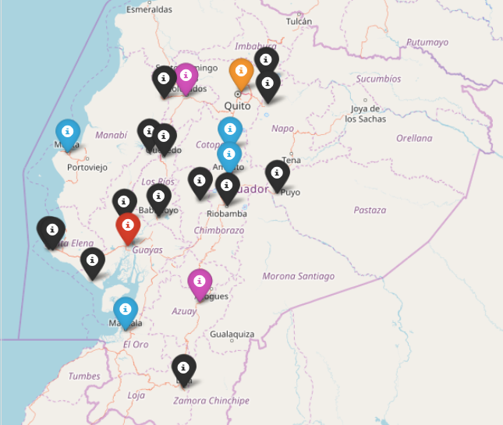
1.1. Competition Description
Corporacion Favorita: A grocery chain in Ecuador with over 100 stores.
Competition Description: Using historical sales records and auxiliary information to predict the unit sales for 16 days in future for thousands of items sold at different Favorita stores located in Ecuador.
Notes:
The problem stems from a kaggle competition
that requires using historical sales records and auxiliary information
to predict the unit sales for 16 days in future for
thousands of items sold at different Favorita stores located in Ecuador.

Slide 5
1.2. Problem Deconstruction from Description
Using historical sales records and auxiliary information to predict the unit sales for 16 days in future for thousands of items sold at different Favorita stores located in Ecuador.
Input Domain
Function Domain
Output Domain
Task Domain
Raw Data
Time Series Prediction
Abstract Target
Model Domain
What is Feature?
Machine Learing Model
What is Label?
Notes:
From the description of the problem, we can see the following information:
In Task Domain , the competition provided some unprocessed data with an abstract task objective
But we can see that this is a Time Series Prediction class task
Correspondingly, In model domain we will use machine learning methods to complete this task
So we must determine the input features of the model in Input Domain
and the output labels of the model in output domain

Slide 6
1.3. Problem Reconstruction from Data
Task Domain
Raw Data
Abstract Target
Historical sales records: train.csv
Auxiliary information: items.csv; stores.csv; sample_submission.csv; holidays_events.csv; oil.csv.
Sales Setting for the Next 16 Days: test.csv
Unit sales for 16 days in future
Records and future-setting of each items in each stores
16-days-unit-sales of each items in each stores
Model Domain
What is Feature?
What is Label?
Form of the features: Several Period Featur-Batchs. One 16-day-period generate one Featur-Batch. Content of the features: Before-period-features and Inside-period-features.
Unit_sales_vector for 16 days in future:
[unit_sales_{Day0},...,unit_sales_{Day15}]
One Feature-Batchs of 16 Days as One Input Sample
One 16-dimension Label-Serie as One Output
Notes:
From the provided data, I can further classify the data into three categories:
Historical sales records, Auxiliary information, Sales Setting for the Next 16 Days
They are all Records and future setting of each item in each store
The goal is to predict unit sales of each item in each store within a sixteen day cycle
The form and content of the preliminary planning features are as follows:
Using a sixteen day period as the period, form a Feature Patch based on Before period features and Inside period features
The preliminary planned label format is as follows:
One 16 dimension Label Series

Slide 7
1.4. From Structure to Pipeline
Input Domain
Function Domain
Output Domain
Historical records of each items in each stores
Time Series Prediction
16-days-unit-sales of each items in each stores
Task Domain
1. Exploratory Data Analysis
3. Model Selection
6. Prediction
Preprocessing
Data-Adaptability
Model Application
Exploration
Consumption
Result Visualization
Model
Domain
2. Feature Engineering
4. Model Training
5. Model Evaluation
Feature Generation
Trainset and Val-set
Normalized Weighted Root Mean Squared Logarithmic Error (NWRMSLE)
Feature Selection
Model Tuning
One Feature-Batchs of 16 Days
LGBM-Model
One 16-dimension Label-Series
Notes:
From this, we can conclude our technical roadmap:
Firstly, conduct EDA and data preprocessing to explore and sort out the possibility of transitioning from data to features
Secondly, after understanding the data, perform feature engineering to determine the content and form of features, and then select excellent features
Afterwards, you can select and train an efficient model
Finally, apply the NWRMSLE specified in the competition to evaluate the training effect and apply the model to prediction

Slide 8
2. From Data to Feature (INPUT DOMAIN)
Notes:
We first explore how to construct excellent input domains from data to features

Slide 9
2. From Data to Feature (INPUT DOMAIN)
Input Domain
Historical records of each items in each stores
2.1 Data Load: What do we have after loading the row data?
1. Exploratory Data Analysis
2.2 EDA: What patterns can be found from the row data ?
Preprocessing
Exploration
2.3 Data Preprocessing: What is an effective form of data organization?
2. Feature Engineering
2.4 Feature Generation: What is the form and content of feature input?
Feature Generation
Feature Selection
One Feature-Batchs of 16 Days
2.5 Feature Selection: What are good features?
Notes:
Mainly divided into five parts

Slide 10
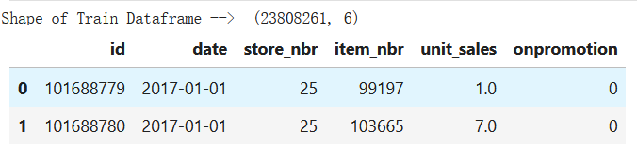
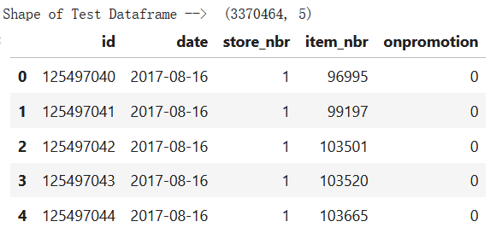
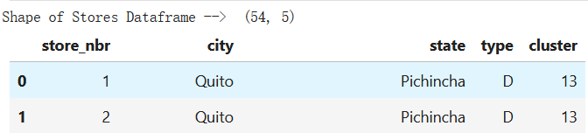
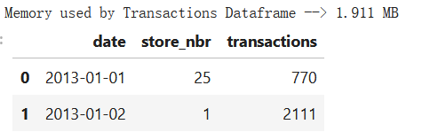
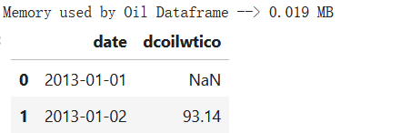
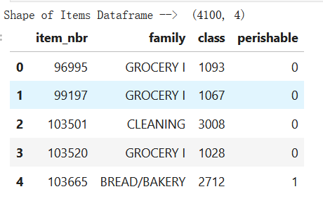
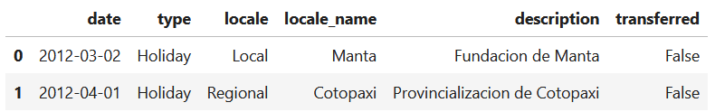
2.1. Data Load: Data Format
What do we have after loading the row data?
Historical sales records: train.csv
Sales Setting for the Next 16 Days: test.csv
Auxiliary information: items.csv; stores.csv;
transactions.csv;
holidays_events.csv; oil.csv.
train.csv
test.csv
stores.csv
transactions.csv
oil.csv
items.csv
holidays_events.csv
Notes:
Firstly, we need to import data.
Previously, we have categorized several data tables into the three categories mentioned earlier

Slide 11
2.1. Data Load: Data Type
Historical sales records: train.csv
Sales Setting for the Next 16 Days: test.csv
Auxiliary information: items.csv; stores.csv;
transactions.csv;
holidays_events.csv;
oil.csv.
Puzzled Data
Selectively
Waive
transactions.csv
oil.csv
holidays_events.csv
Trunk Data
Mainly Dependend
train.csv
test.csv
Identity Data
Organizational
Key
items.csv
stores.csv
Notes:
Here, we will further observe the content, data volume, and relationships of the data table,
To make a preliminary judgment on how we should use this data with different attitudes,
Here, I have identified three different paths for data analysis and processing based on observation：

Slide 12
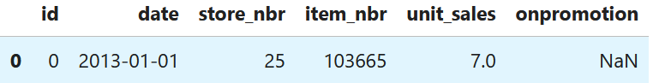
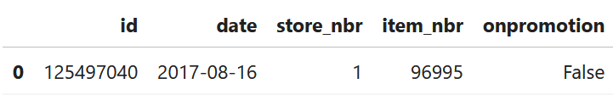
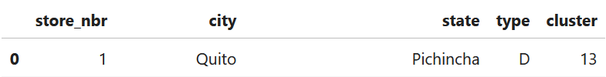
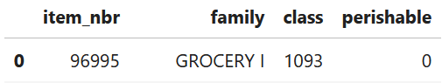
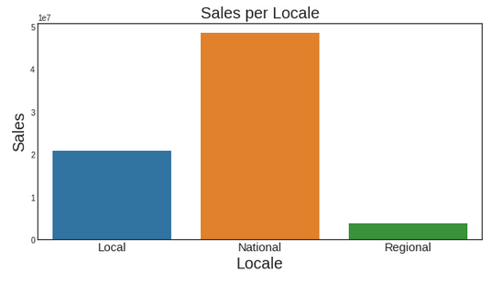
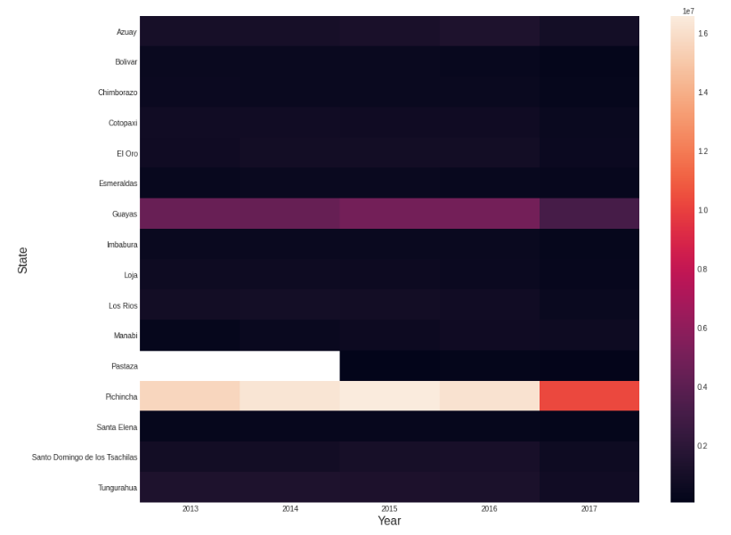
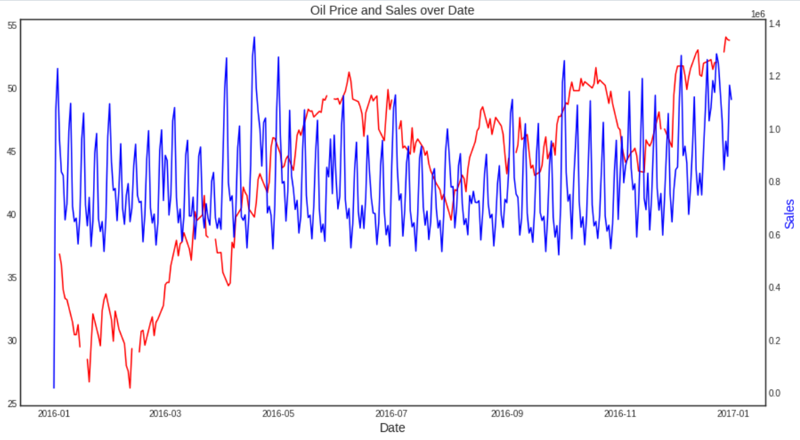
2.2. EDA:
train.csv
test.csv
Trunk Data
EDA on
the relationship
between different Features and Target
Mainly Dependend
stores.csv
items.csv
Identity Data
Jointly EDA with Trunk Data
Organizational
Key
transactions.csv
holidays_events.csv
oil.csv.
Puzzled Data
EDA on Distribution -> EDA on Correlation ->
Whether a good feature?
NO!
Selectively
Waive
Two points to note for EDA on Huge Data: 1. Memory management and garbage collection 2.Select a scope
Notes:
I first define train.csv and test.csv as trunk data, with them as the main information dependencies for EDA exploration
At the same time, I found that stores.csv and items.csv can be connected to the trunk data through key values,
so they can be used as Organizational Keys for EDA along with the trunk data
The remaining data tables have a relatively small amount of data,
and after conducting preliminary EDA on their distribution or distribution,
it was also found that their data lacks regularity and is not a good feature.
So I will mainly introduce EDA for trunk data

Slide 13
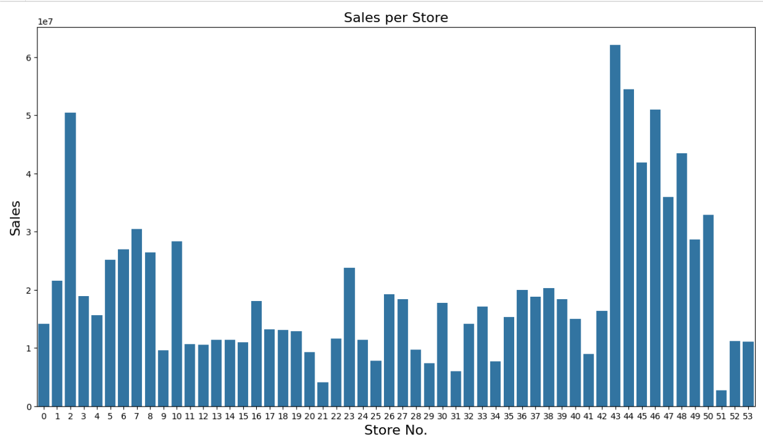
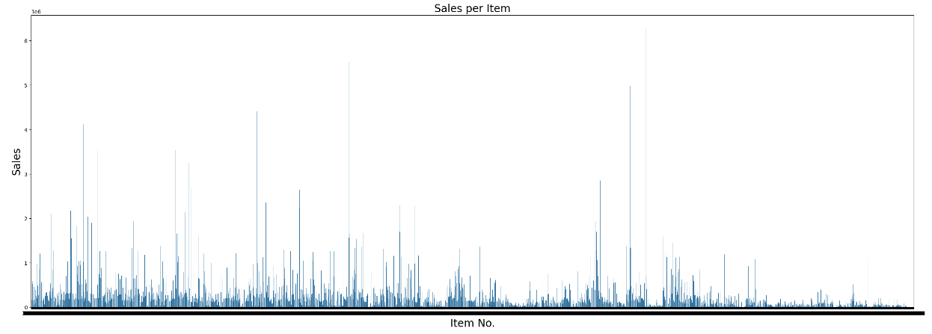
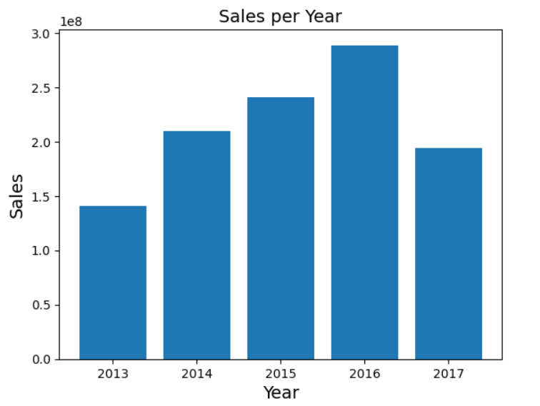
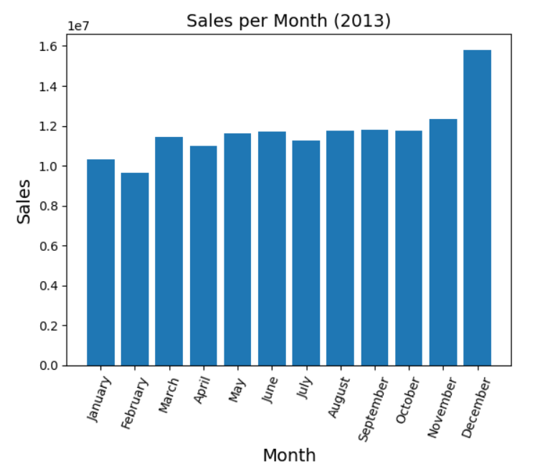
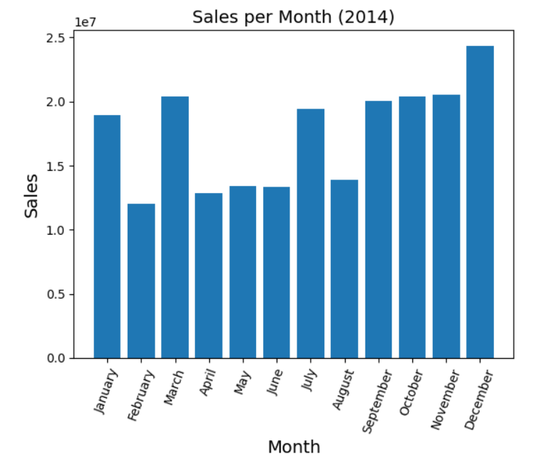
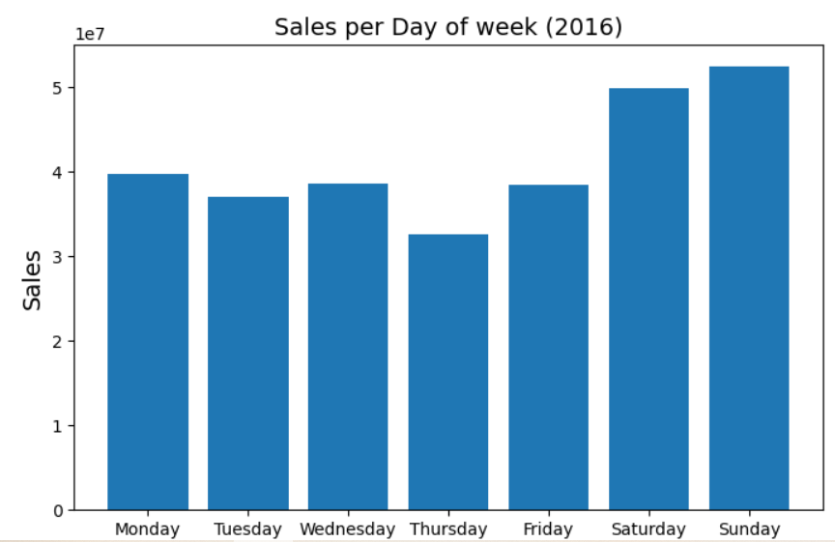
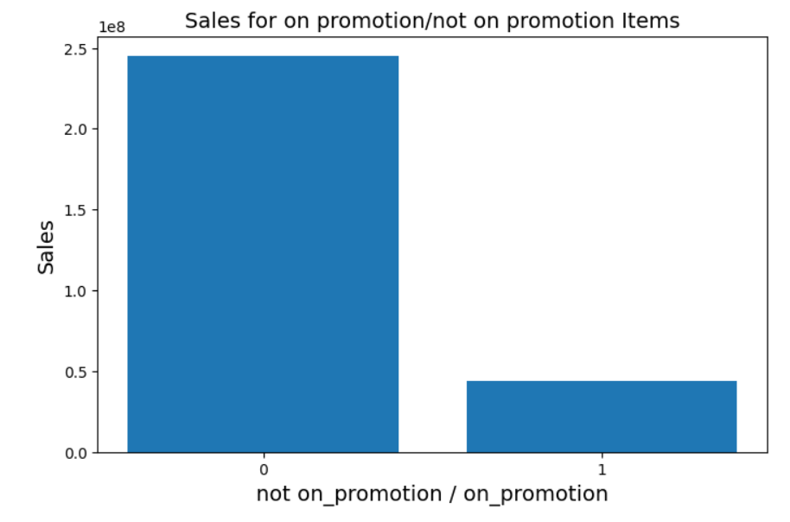
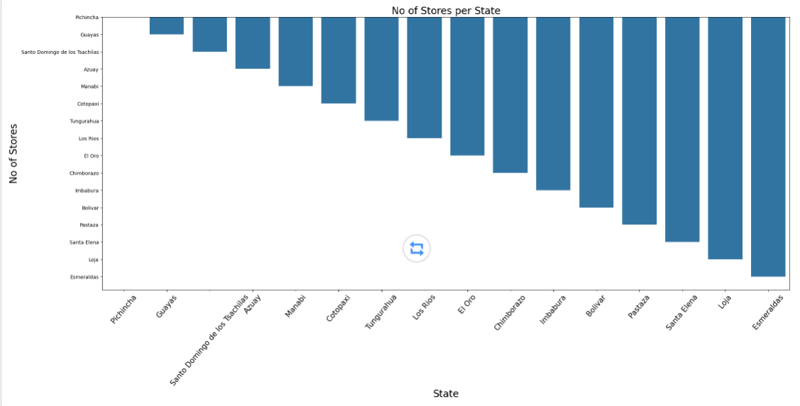
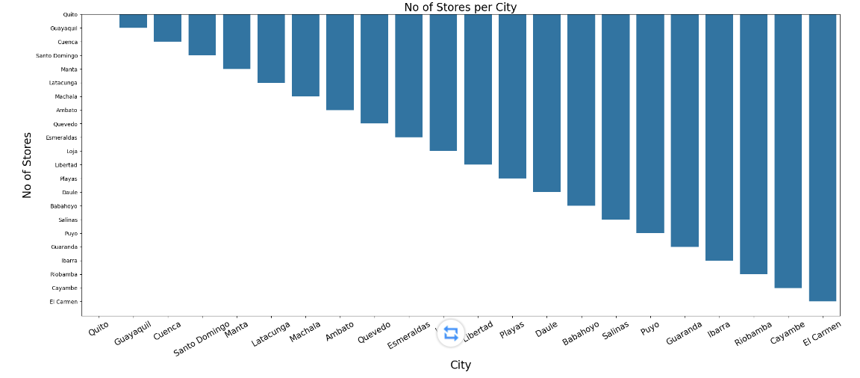
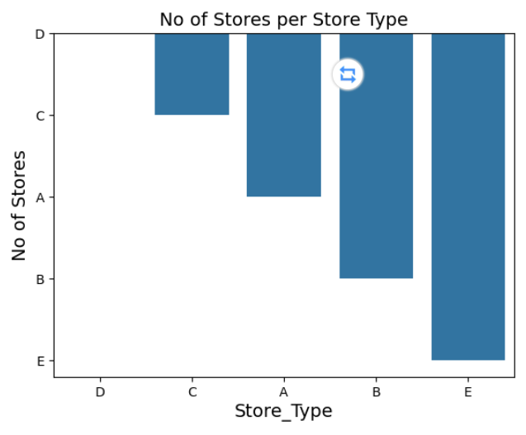
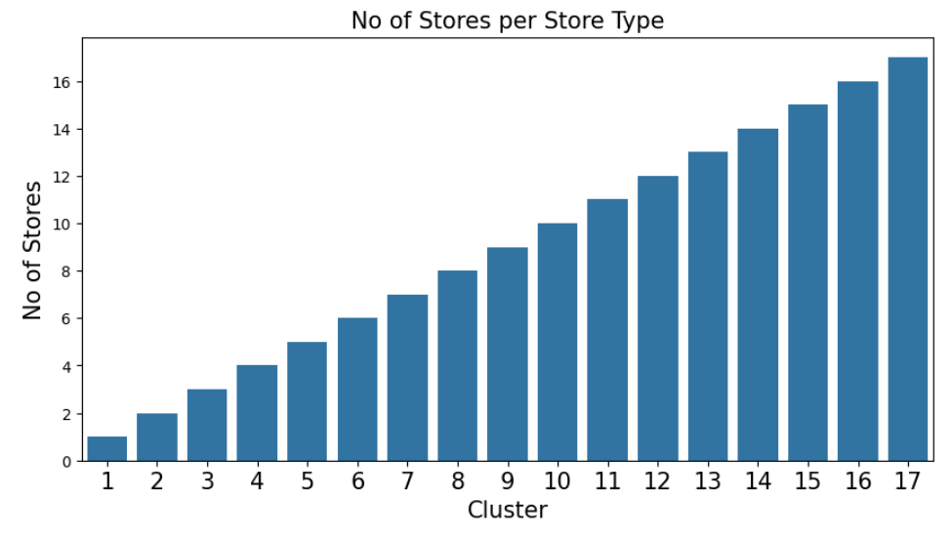
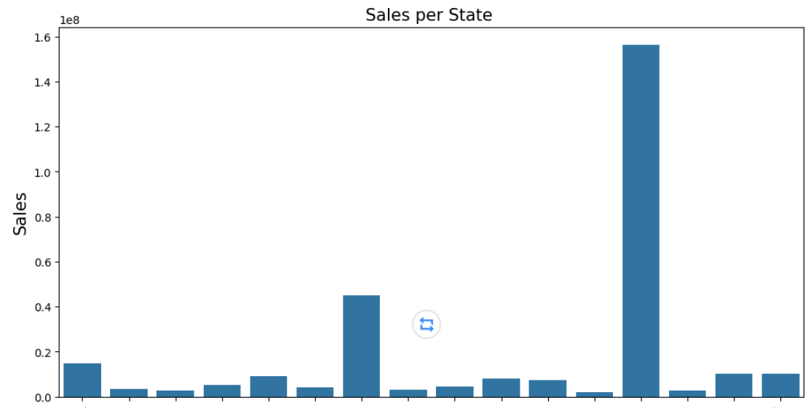
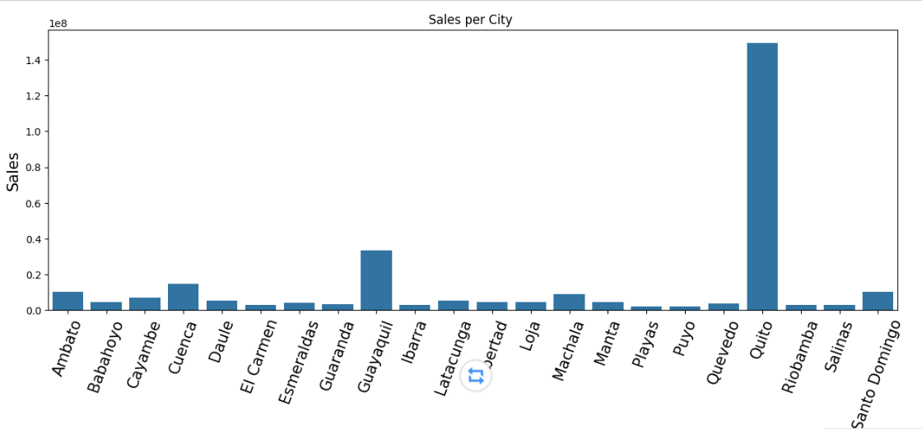
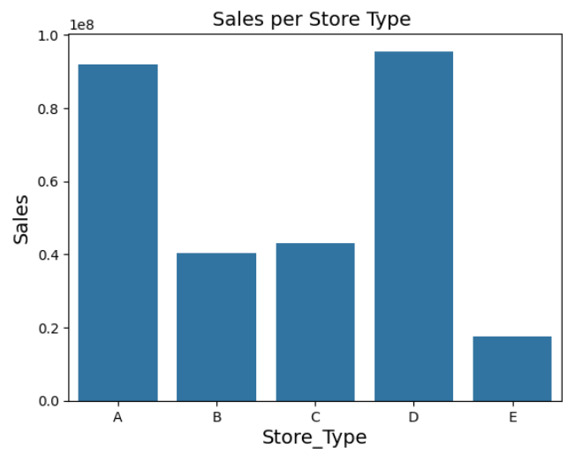
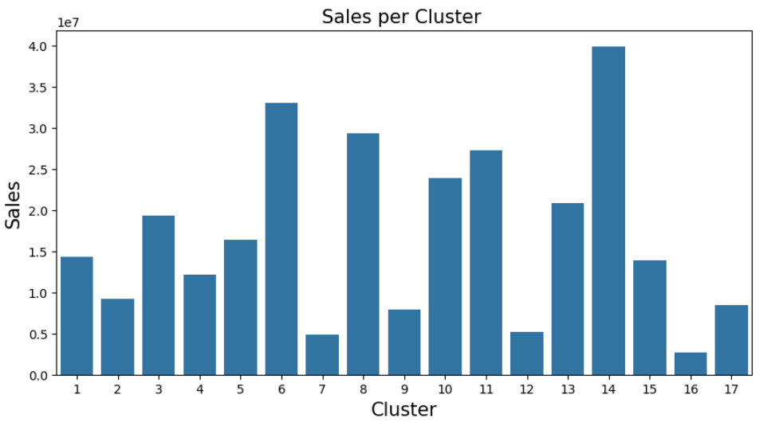
2.2. EDA:
The store numbers range from 1 to 54.
Store No. 44 has the maximum sales.
Store No. 52 has the minimum sales.
Only few items have very high sales.
Variation can be seen in sales for different item no.'s
Given Data is from 2013 to 2017.
Sales are increasing.
Sales in 2017 hasn't finished yet
Date: December max <-> February min(Christmas prefered.)
Day: Sunday&Saturday max <-> Thursday min(Weekends prefered.)
Locate: Pichincha&Guayas max <-> Other much lower ; Quito max
Type: D&C max <-> Type E min; Cluster: 14 max <-> 16 min
Date/Day/Locate/Type/Cluster:
a certain amount of variation
in the average sale numbers.
Important features besides
Temporal-features
Notes:
For the trunk data, I mainly conducted EDA on the relationship between different features and targets,
Date/Day/Locate/Type/Cluster all have a certain amount of variation in the average sales numbers
They are all good non temporal features

Slide 14
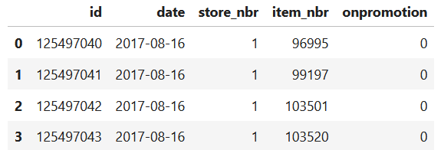
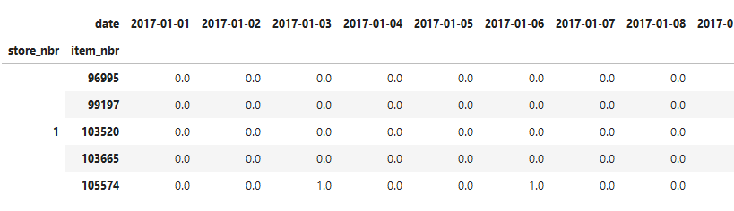
2.3. Data Preprocessing:
Basic data processing: 【 Encoding 】+【 Missing value processing 】
Data Preprocessing: What is an effective form of data organization?
Flowing
time series
'Analyze sales of all products at each time point'
to
'Analyze sales of each product at all times'
Fixed
product/location
Temporal-Sales-features of each product at all times：
Time Series’ Historical Information
Time Series’ In-period Information
Notes:
In EDA, we will find it difficult to demonstrate the temporal nature of the data when analyzing the various attributes corresponding to each ID
But our task is still a time series prediction task,
So after basic encoding and missing value processing,
We should also further optimize the organizational structure of temporal data to make temporal features more clearly displayed.
Therefore, based on the fluidity of time and the certainty of product identification,
I convert 'Analyze sales of all products at each time point' to 'Analyze sales of each product at all times'
Thus obtaining clearer temporal data structure

Slide 15
2.4. Feature Generation:
2.2. EDA:
Date: December max <-> February min(Christmas prefered.)
Day: Sunday&Saturday max <-> Thursday min(Weekends prefered.)
Locate: Pichincha&Guayas max <-> Other much lower ; Quito max
Type: D&C max <-> Type E min; Cluster: 14 max <-> 16 min
Date/Day/Locate/Type/Cluster:
a certain amount of variation
in the average sale numbers.
Important features besides Temporal-features
2.3. Data Preprocessing:
Flowing
time series
Temporal-Sales-features of each product at all times：
Time Series’ Historical Information
Time Series’ In-period Information
'Analyze sales of all products at each time point'
to
'Analyze sales of each product at all times'
Fixed
product/location
2.4. Feature Generation:
What is the form and content of feature input?
Notes:
In EDA and data preprocessing, I discovered non temporal key features in the data and displayed them more clearly.
Next, I need to further determine the form and content of these features as feature data that can be input into the model

Slide 16
2.4. Feature Generation:
Data
Time Series’ Historical and Future Information
Time Series’ Prediction Result
Historical sales records: train.csv
Auxiliary information: items.csv; stores.csv; sample_submission.csv; holidays_events.csv; oil.csv.
Sales Setting for the Next 16 Days: test.csv
Unit sales Feature for 16 days in future
Historical records of each items in each stores
16-days-unit-sales of each items in each stores
Notes:
We are going to use historical records of each items in each stores(in blue box) to 16-days-unit-sales of each items in each stores(in red box).

Slide 17
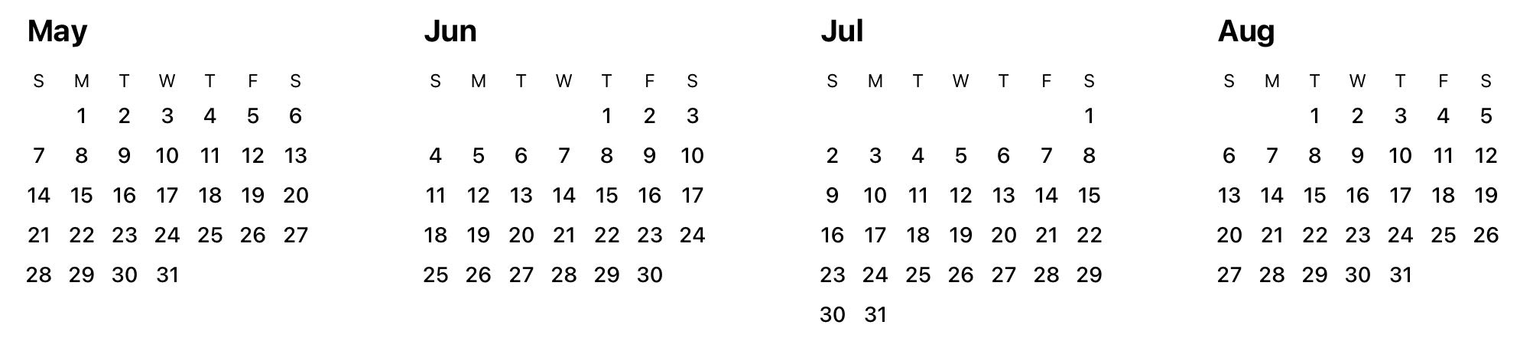
2.4. Feature Generation: Form
···
Form：
Test
[16-day-Time-Series]
Examples of Train [16-day-Time-Series]
Form：Every Input Sample’s Feature Form need be aligned with the Test Time-Series’s Feature
One 16-days-Time-Series
One feature-batch
One input sample
Notes:
Because Test file is a 16-day-Time-Series file.
Every Input Sample’s Feature Form need be aligned with the Test Time-Series’s Feature
One 16-days-Time-Series
One feature-batch
One input sample

Slide 18
2.4. Feature Generation: Content
···
One 16-days Time Series
One feature-batch
One input sample
One Feature-Batch of One 16-Day-Time-Series
Time Series’ Historical Information
Time Series’ In-period Information
Before-period-features:
Use Historical Information before [Period Aug.16 to Aug 31.] to generate Before-period-features for [Period Aug.16 to Aug 31.]
Inside-period-features:
Use In-period Information during [Period Aug.16 to Aug 31.] to generate Inside-period-features for [Period Aug.16 to Aug 31.]
Notes:
One Feature-Batch of One 16-Day-Time-Series consists of two parts.
Before-period-features: Use Historical Information before [Period Aug.16 to Aug 31.] to generate Before-period-features for [Period Aug.16 to Aug 31.]
Inside-period-features: Use In-period Information during [Period Aug.16 to Aug 31.] to generate Inside-period-features for [Period Aug.16 to Aug 31.]

Slide 19
2.4. Feature Generation: Content
One 16-days Time Series
One feature-batch
One input sample
One Feature-Batch of One 16-Day-Time-Series
Time Series’ Historical Information
Time Series’ In-period Information
Before-period-features:
Use Historical Information before [Period Aug.16 to Aug 31.] to generate Before-period-features for [Period Aug.16 to Aug 31.]
Inside-period-features:
Use In-period Information during [Period Aug.16 to Aug 31.] to generate Inside-period-features for [Period Aug.16 to Aug 31.]
Creating Promotional Features
1.Sum of Promotions with past data at different day intervals.
2.Sum of Promotions with future data at different day intervals.
3.Promotion feature (i.e. if there is a promotion or not) for 16 days in past and future
Creating Sales Features Depending on Promotion
1.mean_of_sales of each item sold on promotion over date
2.exponentially weighted sum_of_sales of each item sold on promotion over date
3.mean_of_sales of each item sold without promotion over date
4.exponentially weighted sum_of_sales of each item sold without promotion over date
Notes:
We Create Promotional Features
Such as Sum of Promotions with past data at different day intervals
We Create Sales Features Depending on Promotion
Such as mean of sales of each item sold on promotion over date

Slide 20
2.4. Feature Generation: Content
One 16-days Time Series
One feature-batch
One input sample
One Feature-Batch of One 16-Day-Time-Series
Time Series’ Historical Information
Time Series’ In-period Information
Before-period-features:
Use Historical Information before [Period Aug.16 to Aug 31.] to generate Before-period-features for [Period Aug.16 to Aug 31.]
Inside-period-features:
Use In-period Information during [Period Aug.16 to Aug 31.] to generate Inside-period-features for [Period Aug.16 to Aug 31.]
Creating Sales Features
1.mean of sales of each item over date
2.exponentially weighted sum_of_sales of each item over date
3.mean of difference in sales of each item over date
4.median of sales of each item over date
5.min. of sales of each item over date
6.max. of sales of each item over date
7.std. of sales of each item over date
8.Sales on the nth day in past
9.mean of sales every same day of week during 4 weeks before today
10.mean of sales every same day of week during 20 weeks before today
Creating Count Features
1.Number of days a sale/promotion was made/present (i.e. not equal to 0) for each item
2.Number of days since last sale/promotion (in n_days) for each item
3.Number of days since first sale/promotion (in n_days) for each item
4.Number of promotions in the next two weeks, time before first and last promotion in the same time window
Notes:
We Create Sales Features.
Such as, mean max min of sales of each item over date
We Create Count Features.
Such as the number of days a promotion was made for each item

Slide 21
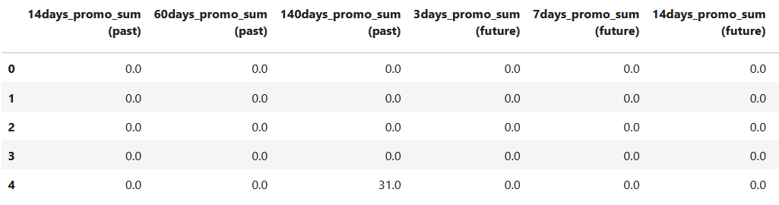
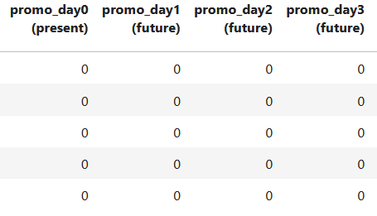
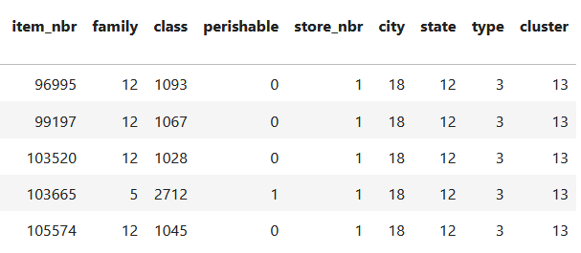

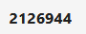
2.4. Feature Generation: Result
One 16-days Time Series
One feature-batch
One input sample
One Feature-Batch (One input sample) of One 16-Day-Time-Series
Time Series’ Historical Information
Time Series’ In-period Information
Other Information and
Unique representation of a product
···
···
···
···
Each row is a feature of ONE items in One stores
This whole data frame is ONE INPUT sample !!!!! We call it one feature-batch
Notes:
This whole data frame is ONE INPUT sample !!!!! We call it one feature-batch.
In the bule box is Time Series’ Historical Information.
In the red box is Time Series’ In-period Information
and in dotted box is Other Information and Unique representation of a product.
Each row is a feature of ONE items in One stores.

Slide 22
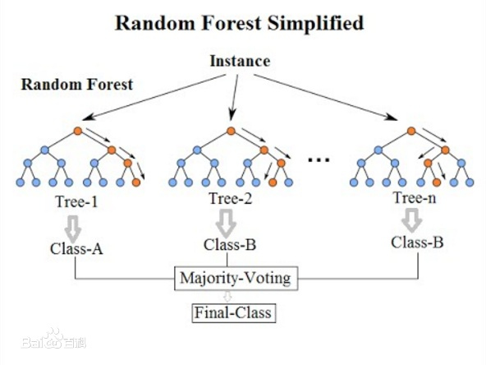
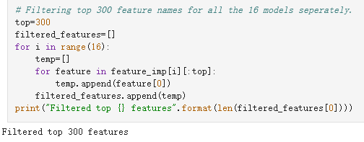
2.5. Feature Selection:
664 Features
Feature Selection: What are good features?
Utilizing the interpretability of Random Forest
664 Features >>> 300 Features
Notes:
There are 633 features are created. But what are good features?
We utilize the interpretability of Random forest to select top 300 features for each day sales unit results.

Slide 23
3. Model Construction (FUNCTION DOMAIN)

Slide 24
3. Model Construction (FUNCTION DOMAIN)
Function Domain
Time Series Prediction
3.1 Model Selection: What kind of model is a good one ?
3. Model Selection
Data-Adaptability
Consumption
3.2 Training data set: What is the structure of the trainset and testset?
4. Model Training
Trainset and Val-set
3.3 Model Tuning: What is the training process of the model?
Model Tuning
LGBM-Model

Slide 25
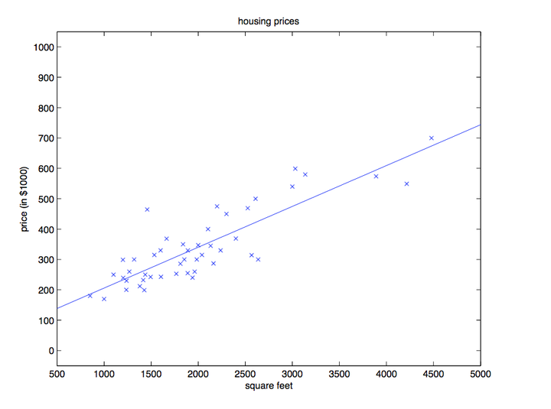
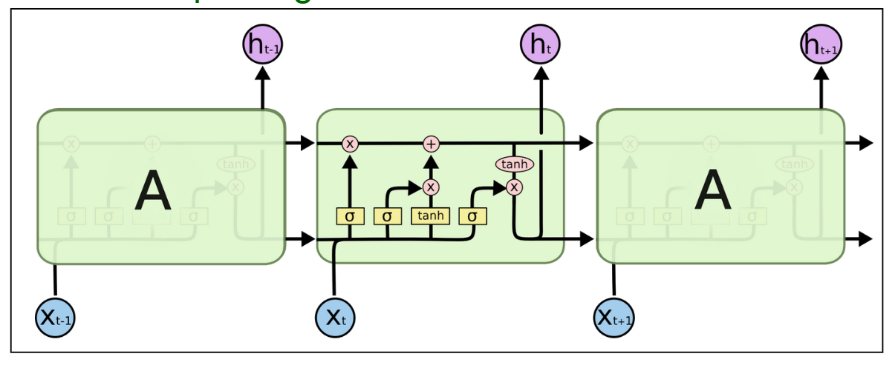
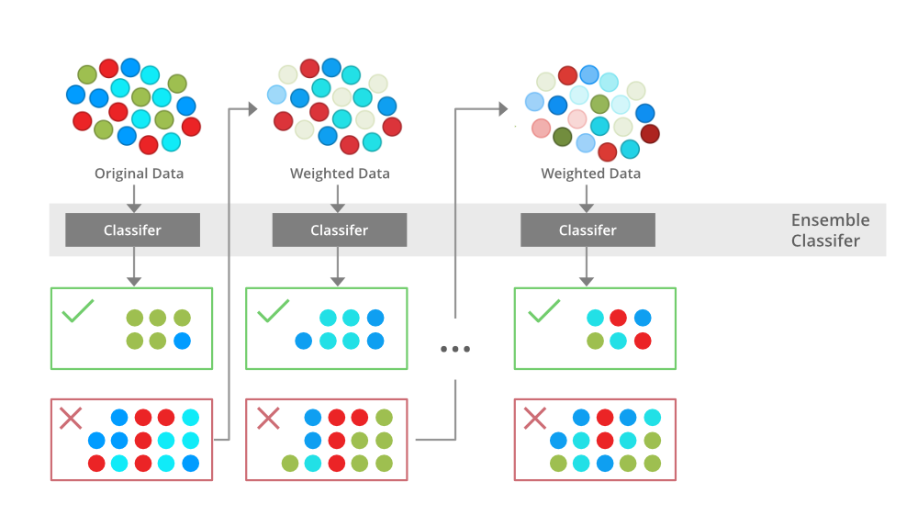
3.1. Model Selection:
After searching and comparing, we firstly choosed XGboost to train the model.
Linear Regression: poor performance for multi features training. Unferfitting problem.
LSTM: time consuming, hard to add other features.
XGBOOST: lower training loss, faster, and good for multi features.
Linear Regression：
• Predict future sales with 30 day historical data
• Poor performance: Simple & Naive
• Time consuming, impossible to add other features
LSTM:
• Need training for each (store, item) pair
• Time consuming, hard to add other features
XGBOOST:
• Leaf-wise Tree Growth: lower training loss, faster
• Prevent overfitting: max_depth, num_leaves, min_data_in_leaf, early_stopping
• Boosting: feature_fraction, bagging_fraction

Slide 26
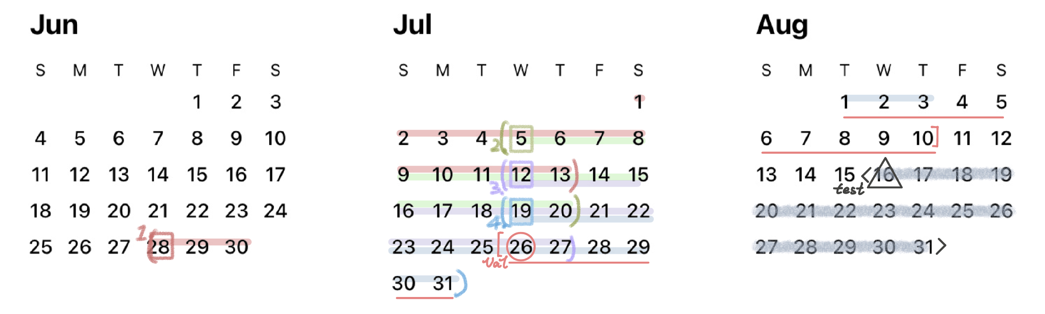
3.2. Trainset:
One input of the model: the batch of [features about the first day of the next 16 days] for each product
One label output of the model: the batch of [unit_sales in the next 16 days] for each product
1 input : a N×300 dataframe
1 training/val data : a N×300 dataframe
1 test data : a N×300 dataframe
1 output : a N×16 dataframe

Slide 27
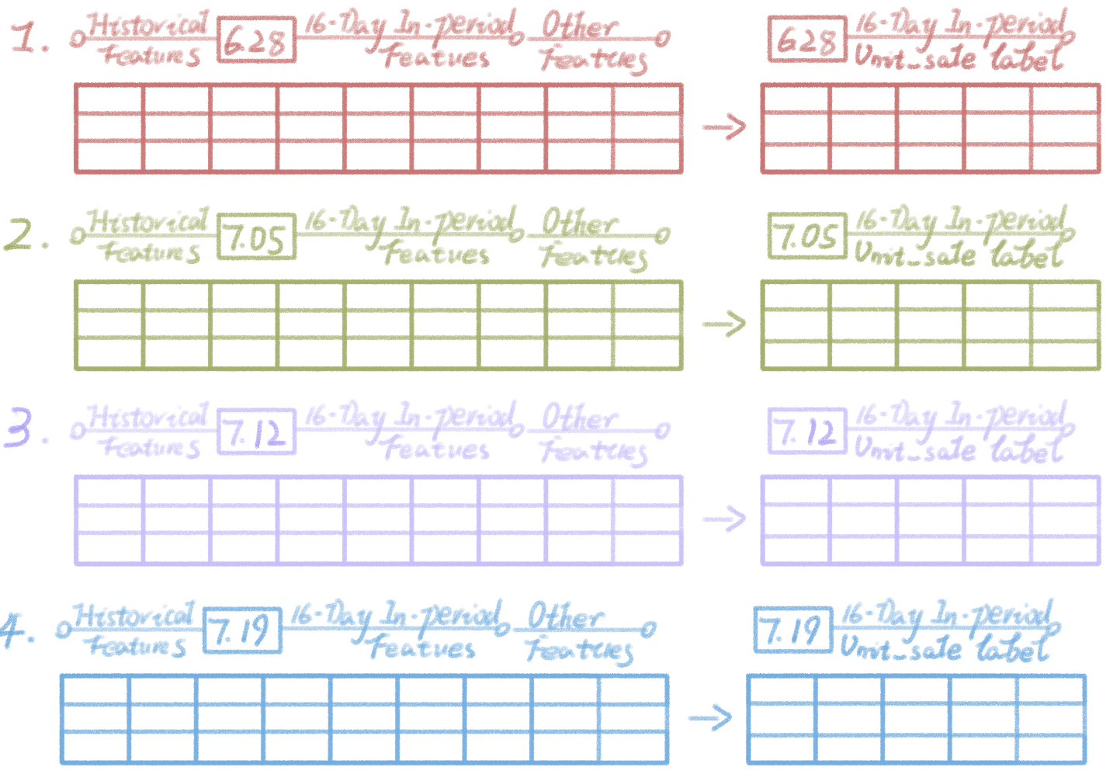
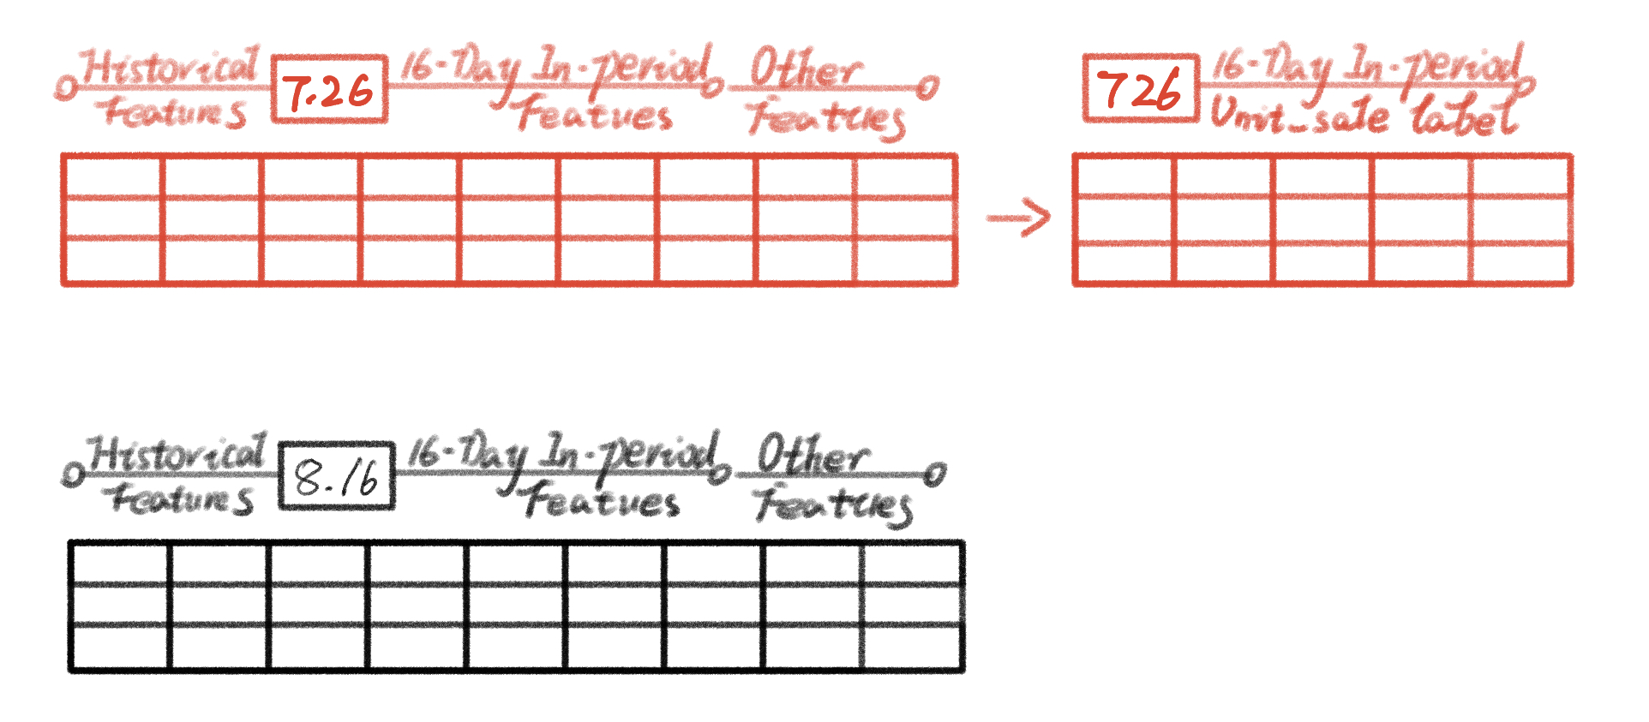
3.2. Trainset:
Valset: 1 val data (a N×300 | N×16) dataframe )
Trainset: 4 training data
(each data is a [N×300 | N×16] ataframe )
Testset: 1 test data (a N×300 dataframe )

Slide 28
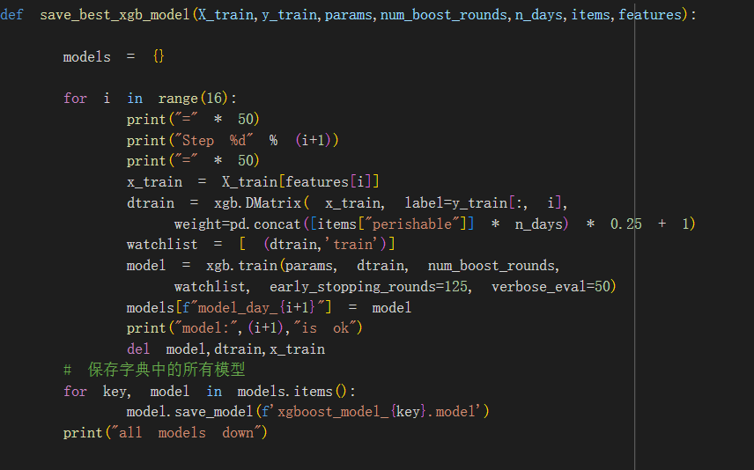
3.3. Model Tuning:
Extract the selected feature sequences
Train sixteen XGBOOST models (each corresponding to a day's prediction)
Input (the feature of [N * 300]_ Batch)
Using models to predict sales for sixteen days
Output(label of[N * 1] [:, i] (unit_sales on day i))
16 rows × 210654 columns

Slide 29
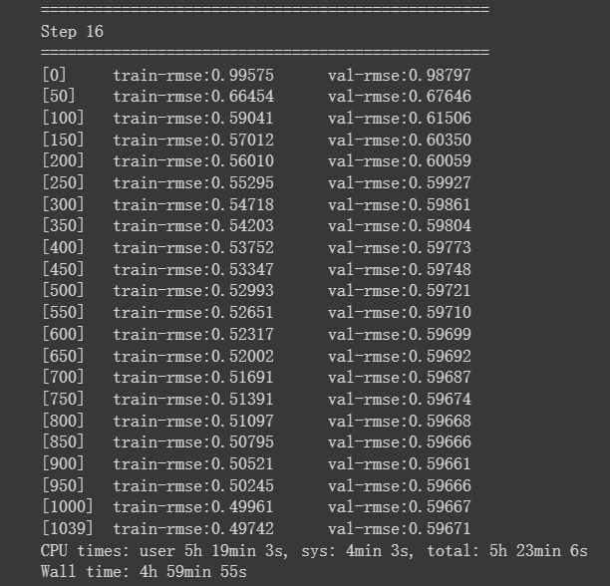
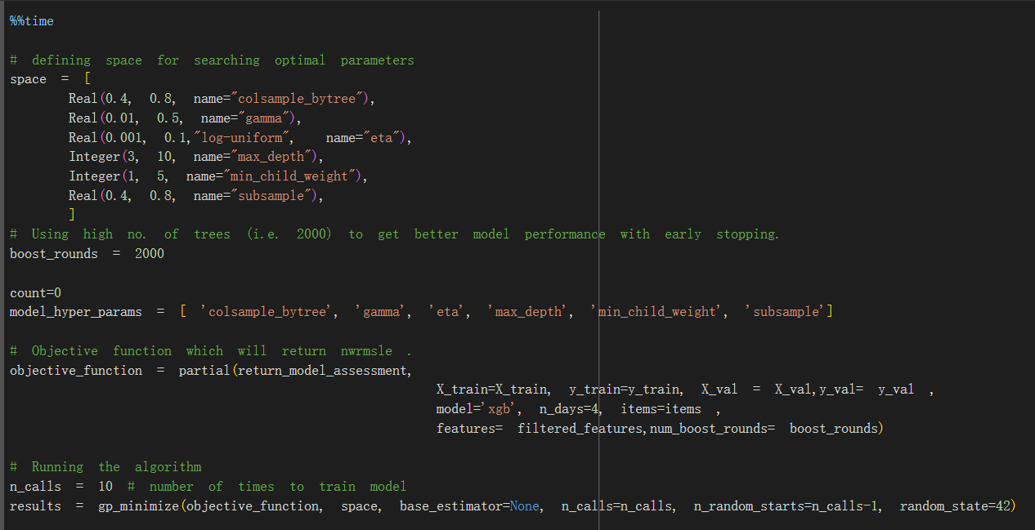
3.3. Model Tuning:
HyperParameters Tuning

Slide 30
4. Evaluation and Improvement (OUTPUT DOMAIN)

Slide 31
4. Evaluation and Improvement (OUTPUT DOMAIN)
Output Domain
16-days-unit-sales of each items in each stores
4.1 Model Evaluation: How is the training effect of the model?
6. Prediction
Model Application
Result Visualization
5. Model Evaluation
4.2 Model Improvement: How to improve the result next?
Normalized Weighted Root Mean Squared Logarithmic Error (NWRMSLE)
One 16-dimension Label-Series

Slide 32
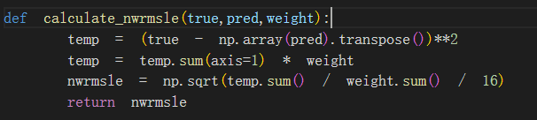
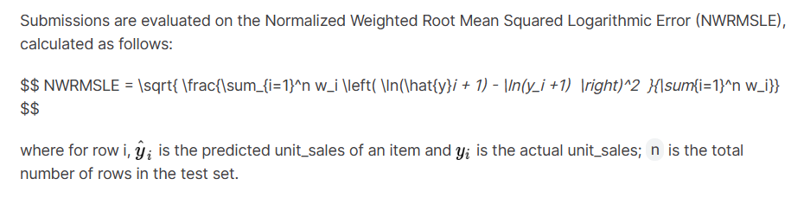


4.1. Model Evaluation:
Evaluation:nwrmsle

Slide 33
4.2. Model improvement:
I
II
The class number and time scope of feature training
XGBOOST
Class Number ↑ Time Scope ↑
Transformer
Next, we will improve the feature selection algorithm and model training. By modifying the number of features and time span. Additionally, we will attempt to use the transformer model, which may be time-consuming

Slide 34
5. Conclusion

Slide 35
Conclusion
Data
Domain
Information’s normalization
-> Feature
Feature’s Explainability
-> Model Input
Result feedback
-> Back to Data
Input Domain
Function Domain
Output Domain
Historical records of each items in each stores
Time Series Prediction
16-days-unit-sales of each items in each stores
Task Domain
1. Exploratory Data Analysis
3. Model Selection
6. Prediction
Model
Domain
2. Feature Engineering
4. Model Training
5. Model Evaluation
One Feature-Batchs of 16 Days
XGBOOST-Model
One 16-dimension Label-Series
Data-Centric
Model-Application
Task-Oriented

Slide 36
The End

